Slide 1


http://www.comp.nus.edu.sg/~cs2100/
Welcome
(AY2022/23 Semester 2)

Slide 2
Welcome to CS2100
Lecturers
Course Materials
Course Description
Assessments
Textbooks
Admin Matters

Slide 3
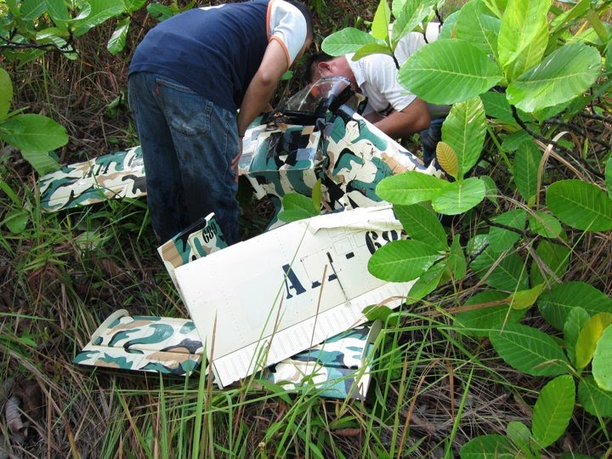
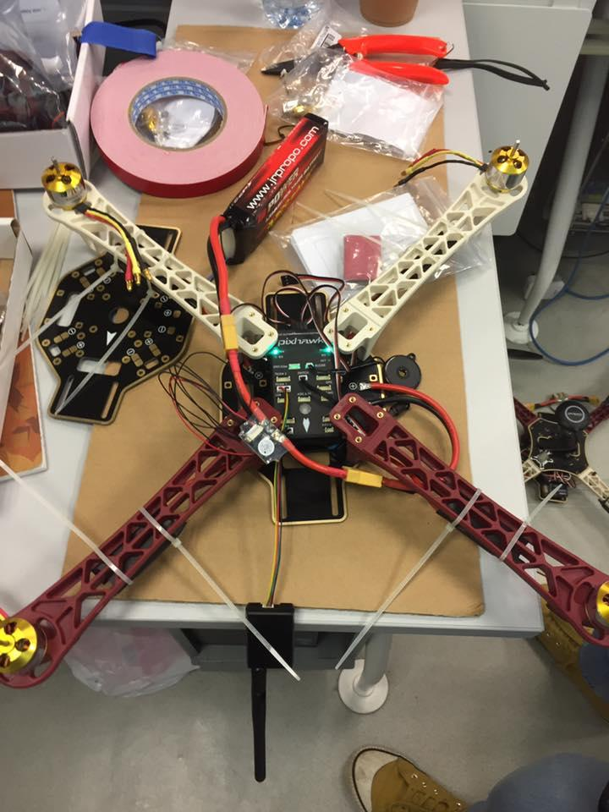
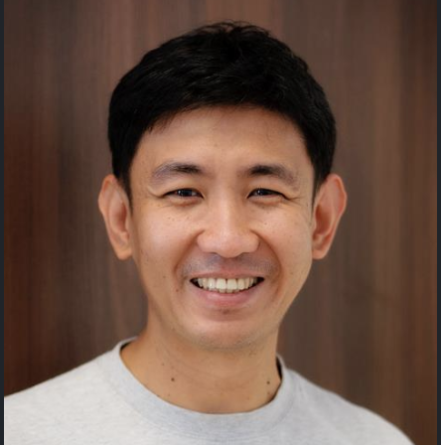
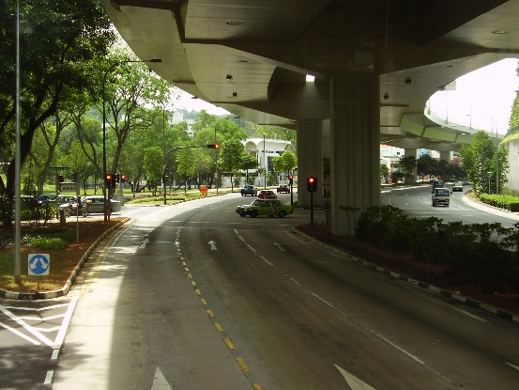
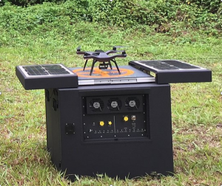
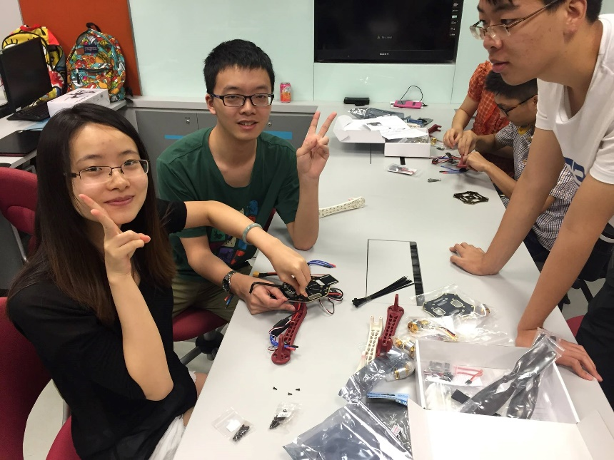
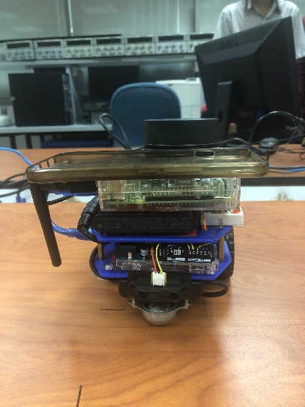
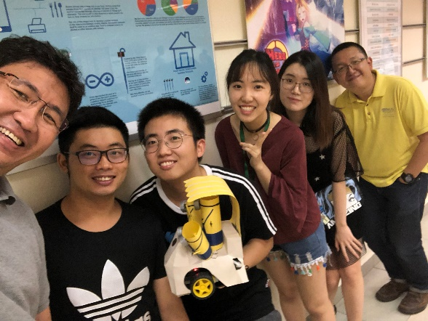
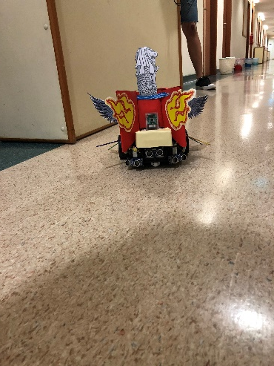

1. Lecturers
Colin Tan
Office: COM2-02-08
Email: dcstanc@nus.edu.sg

Slide 4
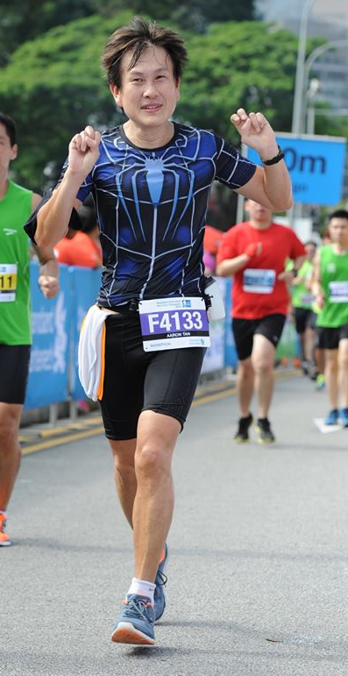
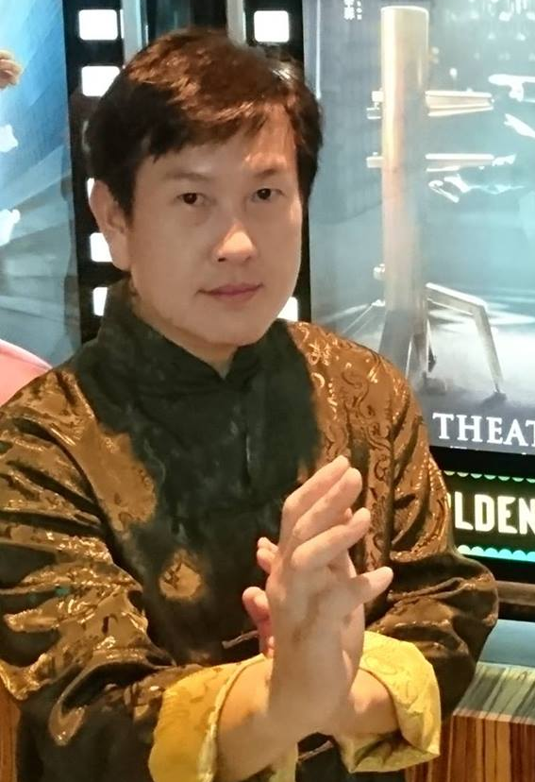
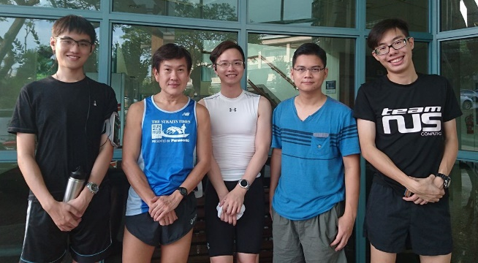
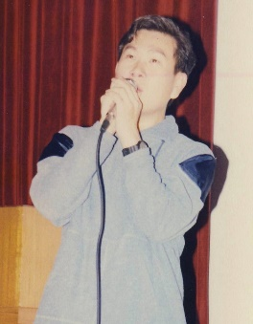
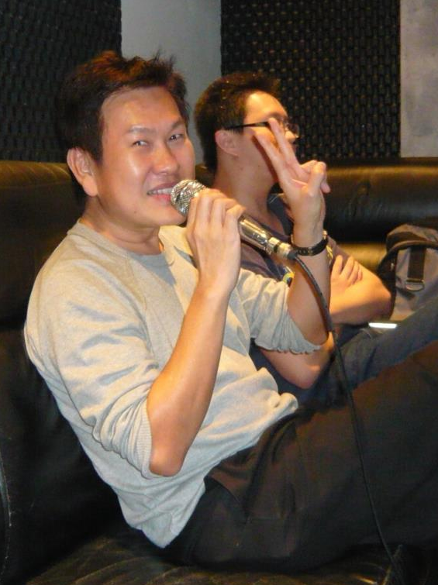
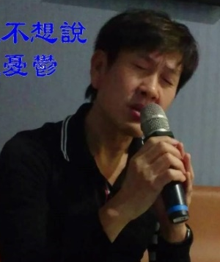
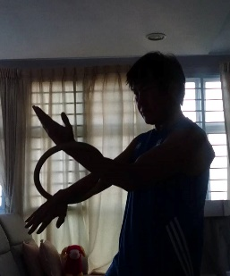
1. Lecturers
Running
Weekly group run with students. You’re welcome to join us!
Check out facebook.
Mr Tan Tuck Choy, Aaron
Office: COM1-03-12
Email: tantc@comp.nus.edu.sg
Singing
Admin appointment:
Assistant Dean (Undergraduate Studies)
Wing Chun
Karaokeing with students.

Slide 5
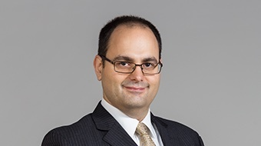
1. Lecturers
“I am a neutrino”
Ask me what this means when you meet me.
Carlson, Trevor
Office: COM3-02-10
Email: tcarlson@nus.edu.sg

Slide 6
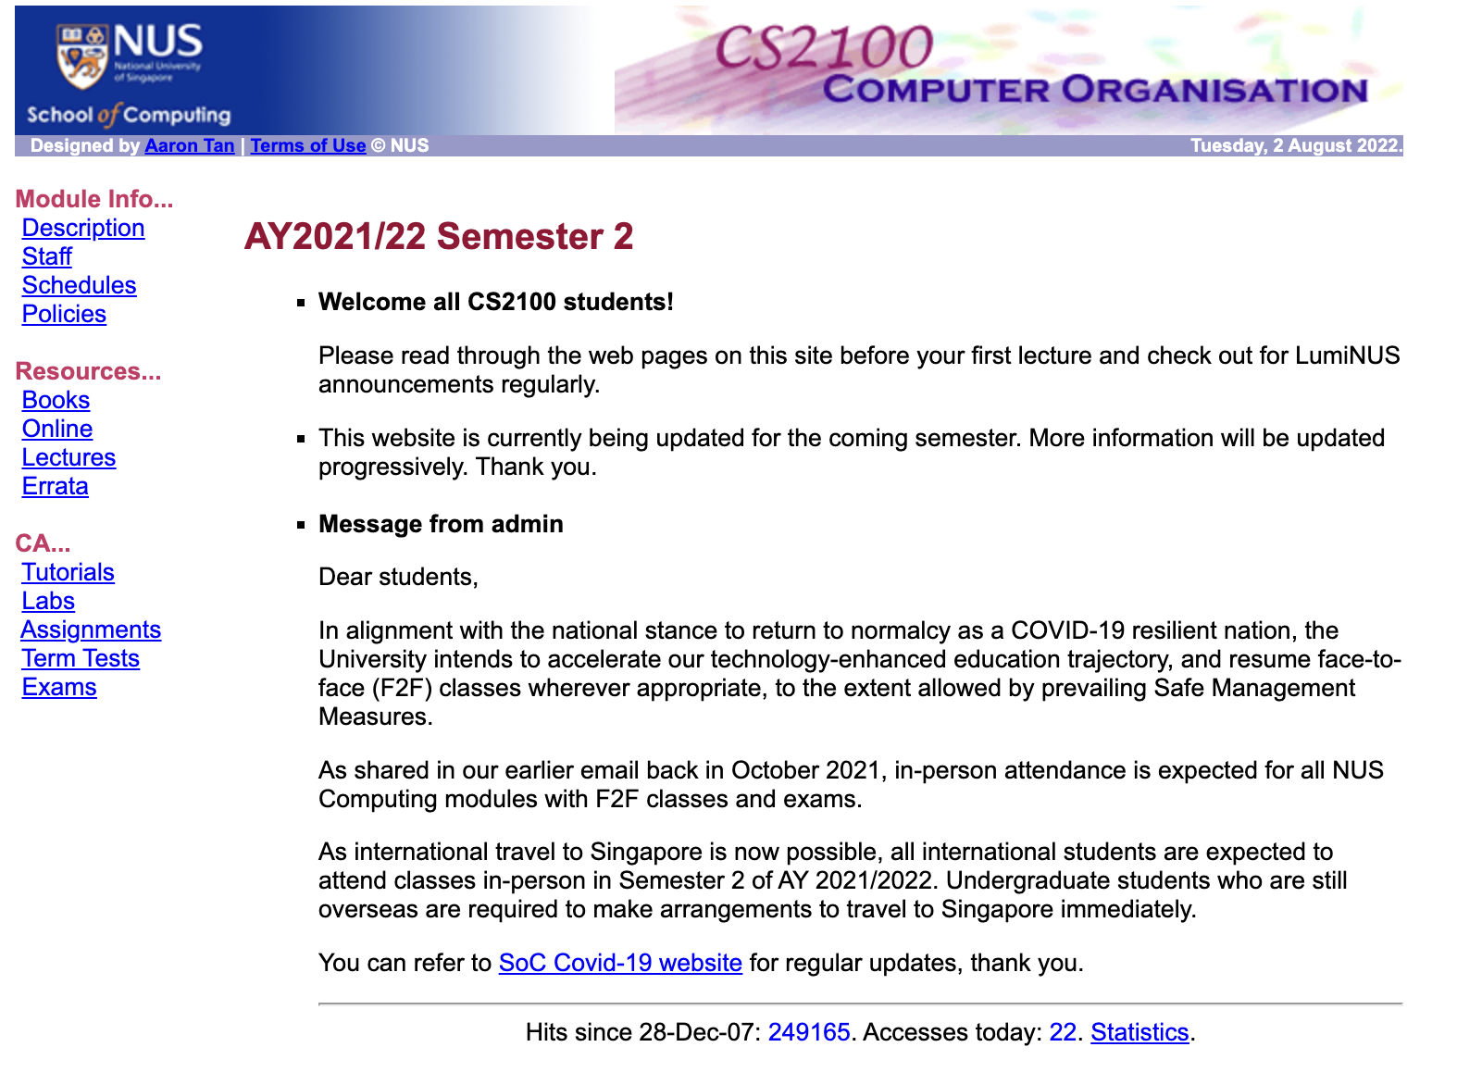
2. Course Materials
Canvas
https://canvas.nus.edu.sg
CS2100 website (Good source of past year papers)
https://www.comp.nus.edu.sg/~cs2100

Slide 7
2. Course Materials
Credit for Lecture Materials
All materials used in this course are from A/P Aaron Tan:
Colin’s parts may contain minor modifications and additions/deletions.

Slide 8
3. Course Description (1/2)
The objective of this module is to familiarise students with the fundamentals of computing devices
The basics of data representation
How the various parts of a computer work, separately and with each other
Topics
C programming language
Data representation and number systems
Assembly language
Processor datapath and control
Pipelining
Cache
Combinational and sequential circuit design

Slide 9
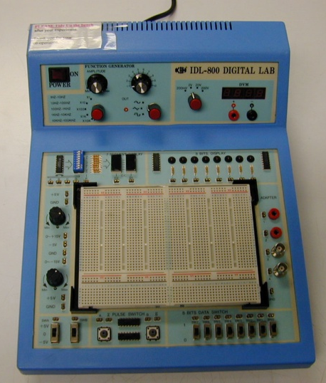
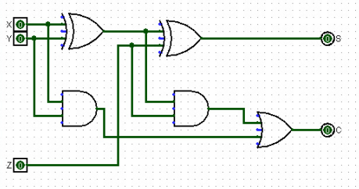
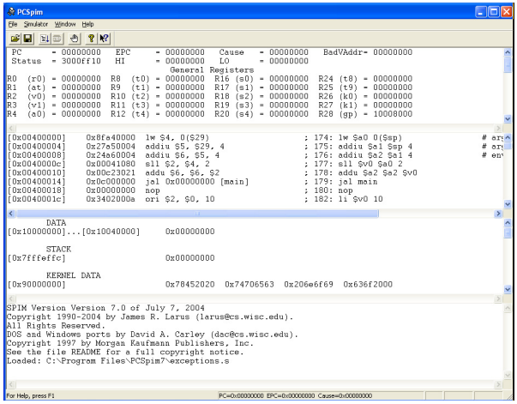
3. Course Description (2/2)
Practical aspects
Logic design experiments
Logisim software
QTSpim software

Slide 10
4. Assessments
CA component | Weightage
Lecture quizzes | 5%
Tutorial attendance | 1%
2 Assignments | 10%
Labs | 14%
Mid-term test * | 20%
Final exam * | 50%
* Face-to-face. Venues TBA.

Slide 11


5. Textbooks
Digital Logic Design (DLD) 2nd edition by Aaron Tan McGraw-Hill
Book + ebook bundle (include errata sheet)
Please refer to module website “Errata” page for errors in the book.
Computer Organization and Design (COD), 4th edition by David A. Patterson and John L. Hennessy, 4th ed, Elsevier

Slide 12
6. Admin Matters (1/2)
CS2100 is taught in Blended Learning mode.
All course materials (lecture slides, tutorial questions, lab questions, etc.) will be uploaded on Canvas week-by-week
Recitations start in Week 2 (16 January 2023)
Tutorials and labs start in Week 3 (23 January 2023)
Mid-term test
11 March, 9 am to 10.30 am. (Tentative)
Please check Canvas announcements for updates
Please post your queries on Canvas forums
Everybody can help answer and everybody can read the answers
Email instructors at colintan@nus.edu.sg (Colin), tantc@comp.nus.edu.sg (Aaron) or tcarlson@nus.edu.sg (Trevor) for personal matters.

Slide 13
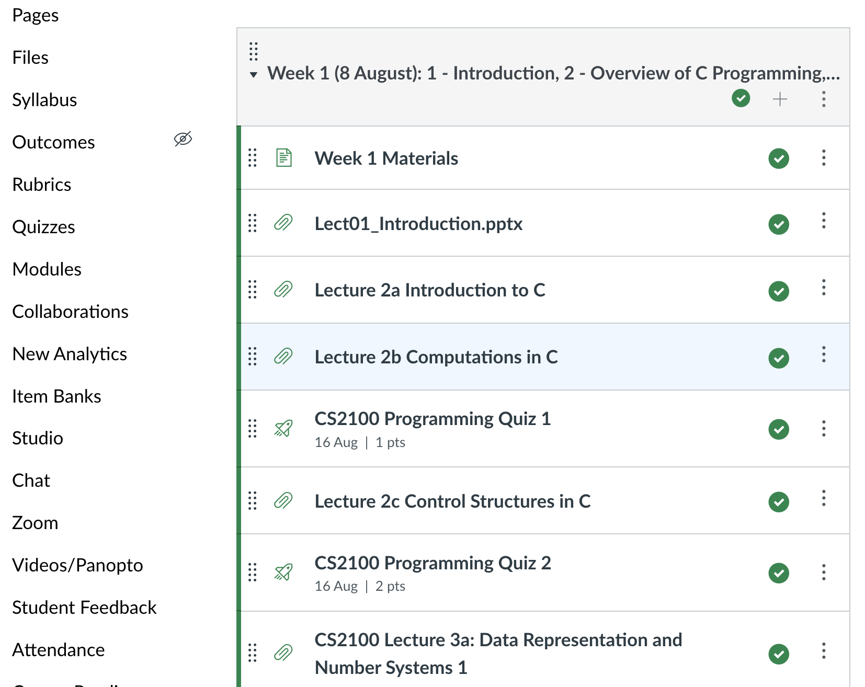
6. Admin Matters (1/4)
CS2100 is taught in Blended Learning mode.
Sequence of lectures and quizzes for the week are shown in the CS2100 “Home” screen on Canvas.
Follow the sequence of notes and do the quizzes.
Lecture recordings are in the Videos/Panopto tool on the left of the screen (circled).
Please view all lecture recordings and do all the quizzes for Week n before the start of Week n+1.
I.e. view all the lectures and do the quizzes for Week 1 before the start of Week 2.

Slide 14
6. Admin Matters (2/4)
We will have Recitation Sessions every Monday 10 am to 12 pm. Three concurrent sessions:
Seminar Room 1
LT 19
Zoom
First Recitation is on Tuesday 16 August 2022.
Limited seating!!
F2F venues have a combined capacity of <350. If there is no space please join online.
Advantages:
You’re more likely to pay attention and benefit here than on Zoom. We know this from 2.5 years of running classes on Zoom.
More personal interaction since we’re actually ”there”.
Instructor will stay on to answer questions personally after recitations.

Slide 15
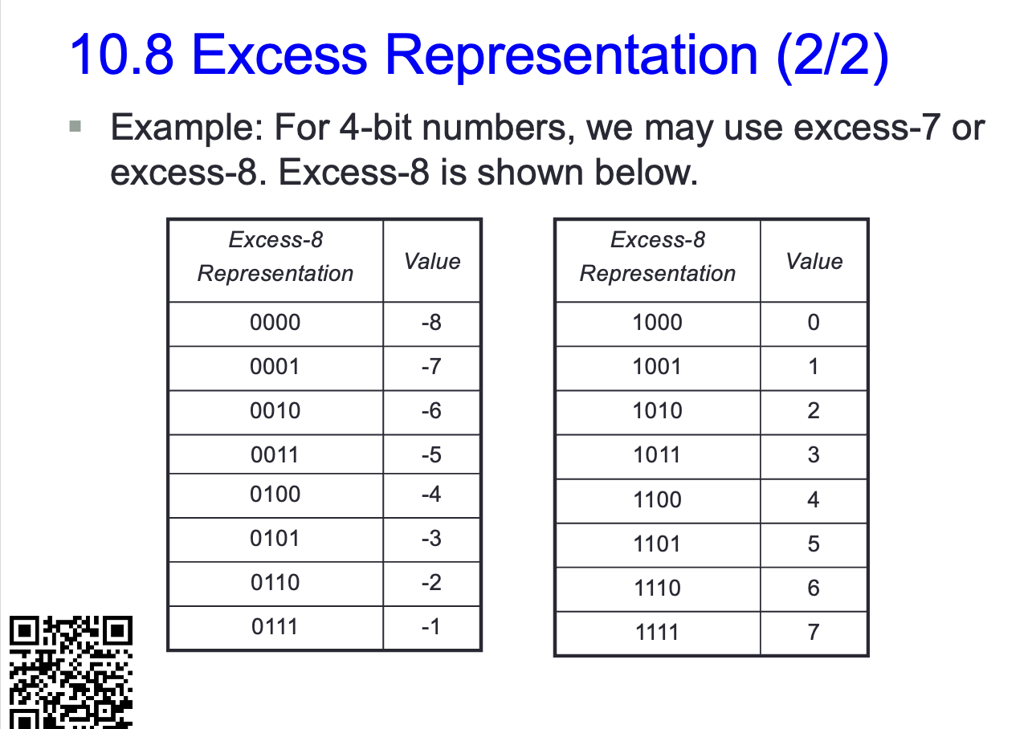
6. Admin Matters (3/4)
What do we do at Recitation?
Every set of Lecture Notes have a QR code and a link to ask questions.
As you view the slides if you don’t understand something, scan the QR code to bring you to a Slido page where you can ask questions.
We will answer these questions at recitation AND do additional exercises (e.g. from past year papers).

Slide 16
6. Admin Matters (2/2)
Online tutorial/lab registration – through ModReg.
Lab group and tutorial group are independent.
Appeal through ModReg, please do NOT email me!
Priority will be given to those without a group, instead of those who already have a group but wish to change.
Do not worry if your lab/tutorial is back to back with the lecture. I will be punctual in starting my lesson and CS2100 lectures/tutorials/labs should end 15 minutes before the hour.
After you get your assigned group, please stick with it.
If you need to attend another group for just one week, please send an email to me (at least a few days in advance) with your reason or attendance will not be taken by the tutor/labTA.

Slide 17
7. IMPORTANT DATES
CS2100 MIDTERM QUIZ
Tentatively Saturday 11 March 2023, 9 AM to 10.30 AM. Venue TBA, subject to Registrar Office.
CS2100 FINAL ASSESSMENT
FRIDAY 28 April 2023, 2.30 PM TO 4.30 PM, venue TBA.

Slide 18
End of File

